Slide 1
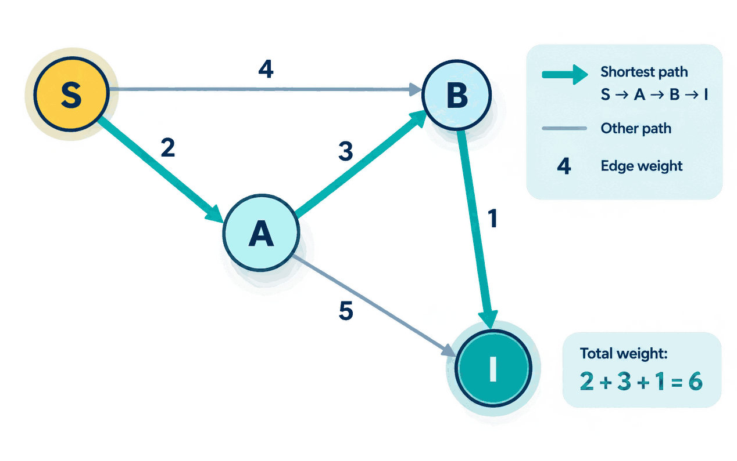
DESIGN AND ANALYSIS OF ALGORITHMS :
Dijkstra’s Shortest Path
Algorithm
Understanding the greedy approach to finding the shortest
path in a weighted graph
Name : Nishika Sumer Kalamkar
PRN : 25070521266
Symbiosis Institute Of Technology
Section : E
Generated by Canva

Slide 2
Introduction to the Shortest Path Problem
1 A graph consists of vertices (nodes) and edges (connections).
2 Edge weights represent cost, time, or distance.
3 The shortest path minimizes the total edge weight between two vertices.
4 Example: the minimum-distance route between two places.
The algorithm selects the unvisited node with the smallest known distance and uses it to explore possible shorter paths.
5 It repeatedly updates the shortest known distances until the shortest paths to the required destinations are determined.
Two possible routes from S to T
4
5
A
S
T
3
10
B
SHORTER ROUTE · TOTAL = 8
Generated by Canva

Slide 3
What Is Dijkstra’s Algorithm?
Dijkstra’s algorithm works by repeatedly choosing the closest unvisited node, updating distances to its neighbors, and marking it as visited
2
6
1 Select the unvisited vertex with the smallest tentative distance.
2 Relax its outgoing edges: replace a neighbor’s distance when a shorter route is found.
3 Mark the vertex visited and continue.
S
3
8
5
Correctness requires non-negative edge weights.
Generated by Canva

Slide 4
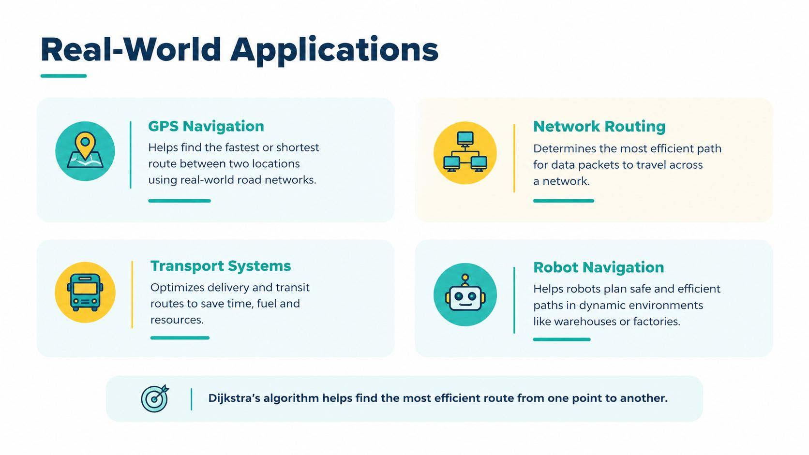
Generated by Canva

Slide 5
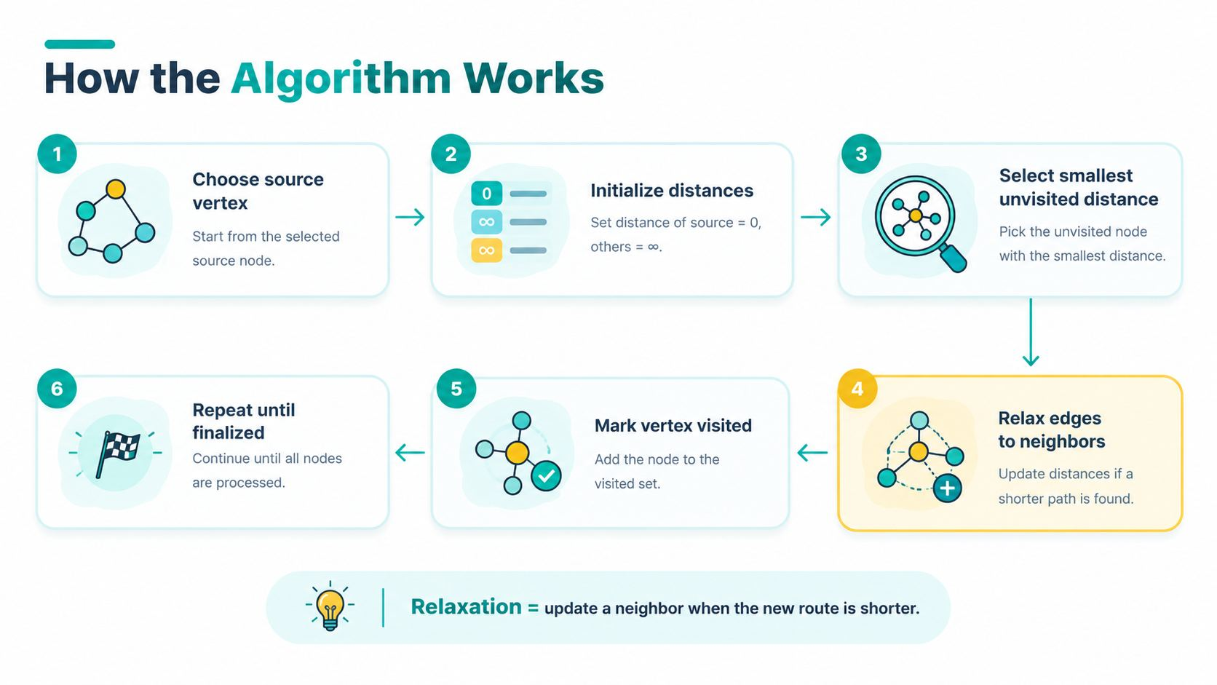


Slide 6
Understanding the Weighted Graph
Example graph used to find the shortest path from A to E
About This Graph
Each edge is a direct connection between two vertices. The number on each edge is its weight (cost, distance, or time).
B
Goal:
Find the minimum-cost path from source A to destination E.
A
4
SOURCE
1
Edge Summary
A - B = 4
2
D
A - C = 1
1
C - B = 2
7
B - D = 1
C - D = 5
5
D - E = 3
C
3
B - E = 7
Key
Source vertex (A)
E
Destination vertex (E)
Intermediate vertex
DESTINATION
Edge / Number = Weight
Key idea: Dijkstra's algorithm always selects the unvisited vertex with the smallest known distance and relaxes its neighbouring edges.
Generated by Canva

Slide 7
Step-by-Step Worked Example
Initial
A 0
B ∞
C ∞
D ∞
E∞
7
4
1
A
B
Visit A
A 0
B 4
C 1
D ∞
E∞
D
Visit C
A 0
B 3
C 1
D 6
E∞
3
2
1
Visit B
A 0
B 3
C 1
D 4
E10
E
C
5
Visit D
A 0
B 3
C 1
D 4
E7
Visit E
FINALIZED
A → C → B → D → E
TOTAL WEIGHT = 1 + 2 + 1 + 3 = 7
Generated by Canva

Slide 8
Algorithm and Pseudocode
●
DIJKSTRA(Graph, source)
dist[v] ← ∞ for every vertex v
dist[source] ← 0
insert source into min-priority queue Q
while Q is not empty:
IMPLEMENTATION NOTE
A priority queue may contain outdated entries. Skip an extracted entry when its stored distance no longer matches dist[u].
KEY IDEA
Relax only when candidate < dist[v]
u ← extract-min(Q)
for each neighbor v of u:
candidate ← dist[u] + weight(u, v)
if candidate < dist[v]:
dist[v] ← candidate
parent[v] ← u
update Q with dist[v]
return dist, parent
Generated by Canva
Generated by Canva

Slide 9
Time and Space Complexity
Adjacency matrix + linear search
Adjacency list
+ binary min-heap
O(V²)
Simple selection of the minimum distance vertex by scanning all V.
O((V + E) log V)
Commonly simplified to O(E log V) for connected sparse graphs.
B
A
C
SPACE O(V + E)
·V = vertices · E = edges
Generated by Canva

Slide 10
Advantages, Limitations & Conditions
ka
• Efficient for non-negative weighted graphs.
• Finds the shortest paths from a source node to every reachable vertex.
• Widely used in navigation and networking applications.
• Simple to understand and implement.
• Works well for large graphs with sparse connections
ADVANTAGES
LIMITATIONS
IMPORTANT CONDITIONS
• Does not work correctly with negative-weight edges.
• May not be the best choice for every type of graph.
• Bellman-Ford is a better option for graphs with negative edge weights.
• Can require more time and memory in some cases.
• Performance may decrease for very dense graphs.
• Every edge weight must be non-negative.
• Unreachable vertices remain at infinity (∞) distance.
• Implementation choice affects execution speed and memory usage.
• The graph's structure and edge weights should remain unchanged during execution.
• The algorithm assumes there are no negative-weight cycles.
+
≥0
!
-
+
*
Generated by Canva

Slide 11
Conclusion & Key Takeaways
1. Dijkstra’s algorithm is an important graph algorithm that helps find the shortest path from a starting node to other nodes in a weighted graph.
2. It follows a greedy approach by selecting the unvisited node with the smallest known distance and exploring possible shorter routes through it.
3. The algorithm continuously updates distances and compares different paths until the shortest routes to the required destinations are determined.
4. It is widely used in real-world applications such as GPS navigation, Google Maps, road route planning, and computer network routing.
A
B
C
E
Generated by Canva

Slide 12
Thank You!
Generated by Canva

